Slide 1

Predicting Corn, Wheat and Soybean Yield Using Meteorological Data and Feature Importance Comparison Among Cultures
Maura Tokay | UMBC DATA606
Notes:
My name is Maura Tokay and for my capstone project I am proposing to use machine learning to predict corn, wheat and soybean yield using meteorological data and compare feature importance among cultures.

Slide 2
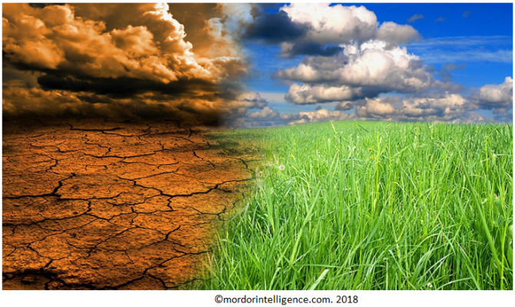
Weather & Agriculture
Precipitation and temperature are the two main characteristics of weather and climate, they also play an important role on the outcome of crop yield.
Notes:
Precipitation and temperature are the two main characteristics of weather and climate, they also play an important role on the outcome of crop yield.

Slide 3
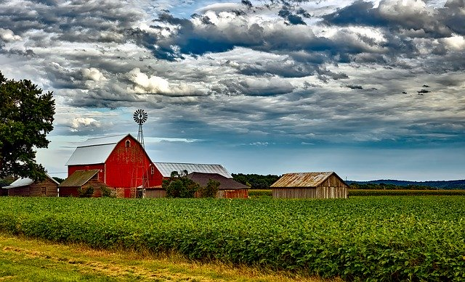
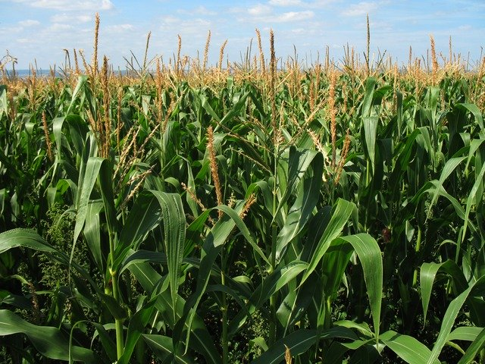
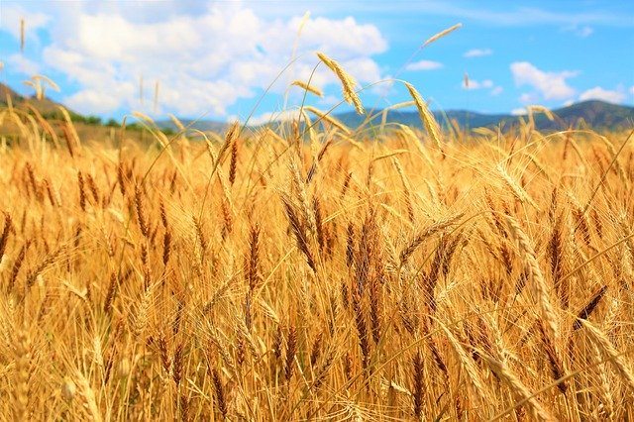
Crop Yield
Use Machine Learning Predictive models to estimate corn, wheat and soybean yield using meteorological variables.
Notes:
To forecast corn, wheat and soybean yield I will use meteorological data in machine learning predictive models like Lasso, Decision Tree Regressor and Random Forest Regressor

Slide 4
Dataset
Farming Systems Project (FSP) is a long-term agroecological research project in Beltsville, MD. The data available for analyses span 20 years, 1996-2016.
Meteorological Data
Date
Temperature (⁰C)
Humidity (%)
Radiation (w/m²)
Daily light integral (mol/m² day)
Wind (m/s)
Rain (mm)
Crop Yield Data
Crop
System
Plot
Grain Yield (kg/ha)
Grain Yield (lb/A)
Grain Yield (bu/A)
Harvest Date
Notes:
The dataset I will use comes from the farming system project that is a long-term agroecological research project in Beltsville, Maryland. The data spams 20 years ranging from 1996-2016. The meteorological data contains temperature, precipitation, humidity, radiation, day light integral and wind. The crop yield data contains harvest date, crop, system, plot and grain yield.

Slide 5
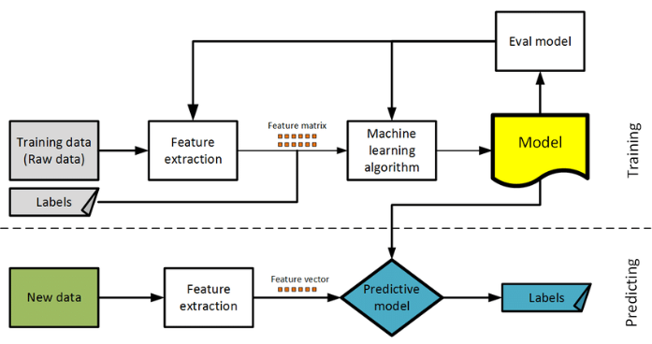
Machine Learning Model
Joint network coding and machine learning for error-prone wireless broadcast - Scientific Figure on ResearchGate. Available from: https://www.researchgate.net/figure/A-flowchart-of-a-supervised-machine-learning-model_fig1_314202159 [accessed 5 Feb, 2020]
Notes:
To create the machine learning model, first we need to extract the features from the training data, then we setup the machine learning algorithm to be used to create the model. Once the model is trained, we do a model evaluation to check the accuracy. If the model has a good performance we can apply the model on new data to predict the outcome.

Slide 6
Project Goals
Predict Crop Yield
Verify Feature Importance Among Crops
Quantify Weather Parameter Importance
Climate Change Impact on Food Security
Notes:
My project goals is to predict crop yield. It will also be interesting to compare feature importance among crops because this might change depending on the crop been studied. If I can quantify the importance of the weather parameter then I can do an analyses of the climate change impact on food security.

Slide 7
Acknowledgment
Questions?
Michel Cavigelli, PhD, USDA
Anne E Conklin, USDA
Contact Maura Tokay at matokay1@umbc.edu
Notes:
I would like to acknowledge Dr. Michel Cavigelli and Ms. Anne Conklin for providing the data that will be used in this project. If you have any questions or suggestions please contact me on the email listed here. Thank you for taking your time to watch my capstone pitch presentation.

